Slide 1
CEMA HEALTH SYSTEM.
A Modern Solution for Efficient Healthcare
Name: Otieno Kennedy Onyango
Date: 26/04/2025

Slide 2
Healthcare in isolation
Healthcare in itself is just a whole set of ministry that entails different departments that in more than one way depend fully on the other. For example, a genecologist depends on the surgeon to know when and how to operate. A diabetic patient for instance really needs to feed well and that means that a nutritionist and a diabetes doctor would definitely most a time work together for the wellness of their client.

Slide 3
1.The user will have a better chance to track the clients record and progress 2. The client’s health will also be at a better position since monitoring is not done manually anymore 3. The user will have an easy time to also share his records kept with the other in need of it anytime
Impacts on patients( The Clients) AND USERS

Slide 4
CEMA provides a collaborative platform to revolutionize healthcare communication. It's designed to break down silos, allowing healthcare providers to work together seamlessly. The result is a holistic view of the patient that drives better care coordination
Cema system introduction

Slide 5
CEMA empowers healthcare providers with a suite of powerful features. First, it provides a secure, centralized repository for patient data, ensuring that everyone on the care team is working with the same, accurate information. It also includes real-time communication tools, like messaging and video conferencing, to enable instant collaboration. CEMA streamlines care with integrated planning and task management, and its API integration with existing systems, such as ehrs, eliminates data silos and manual entry. Crucially, role-based access control protects patient privacy. Together, these features drive improved care coordination, reduce errors, enhance safety, increase efficiency, lower costs, and ultimately, lead to better results for patients.

Slide 6
CEMA’s APIs are the key to connecting the healthcare ecosystem. They allow CEMA to integrate smoothly with other vital systems, such as electronic health records, lab systems, and pharmacies. This seamless integration means several important benefits: it eliminates the need for manual data entry, which reduces the chance of errors; it provides a complete view of the patient's health, pulling information from different sources; and it enables real-time data sharing and communication between all care providers
API-Powered Collaboration

Slide 7
Let's look at how CEMA can transform diabetes management. With CEMA, an endocrinologist can easily share crucial blood sugar data and treatment plans with the patient's primary care physician. A nutritionist can provide personalized dietary recommendations and track the patient's progress, keeping the entire care team informed. And an ophthalmologist can share eye exam results, immediately alerting other providers to any potential complications. This level of coordination leads to significantly improved care and, most importantly, better outcomes for patients with diabetes.
Use Case 1: Diabetes Care: A Team Approach

Slide 8
CEMA also plays a vital role in cancer care, where collaboration is paramount. An oncologist can use CEMA to share complex treatment plans and lab results with surgeons, radiologists, and other specialists. The palliative care team can provide timely updates on pain management and offer essential psychosocial support, ensuring the patient's holistic well-being. A nutritionist can offer tailored dietary guidance to help manage treatment side effects and support the patient's recovery. In oncology, this multidisciplinary approach, facilitated by CEMA, is truly essential.
Coordinated Cancer Care: A United Front

Slide 9
For healthcare providers, CEMA offers a range of benefits that make their work more efficient and rewarding. CEMA streamlines workflows and reduces the administrative burden, freeing up time for direct patient care. It also improves communication and collaboration among team members, provides easy access to comprehensive patient information, supports better and more informed decision-making, and ultimately, increases professional satisfaction.
Benefits for Providers

Slide 10
Benefits for CLIENTS
most importantly, CEMA is designed to benefit patients. It leads to improved care coordination and continuity, which means a smoother, more seamless healthcare experience. It also reduces the risk of medical errors, increases patient engagement and empowerment, supports better management of chronic conditions, and improves overall health outcomes and quality of life. At its core, CEMA is about putting patients first and ensuring they receive the best possible care

Slide 11
Duplication of tests: Patients may be subjected to unnecessary repeat testing, leading to increased costs, inconvenience, and potential exposure to unnecessary radiation or invasive procedures. Conflicting treatment plans: Lack of coordination can result in conflicting treatment recommendations from different specialists, confusing patients and potentially compromising their care.
Negative Consequences for Patients

Slide 12
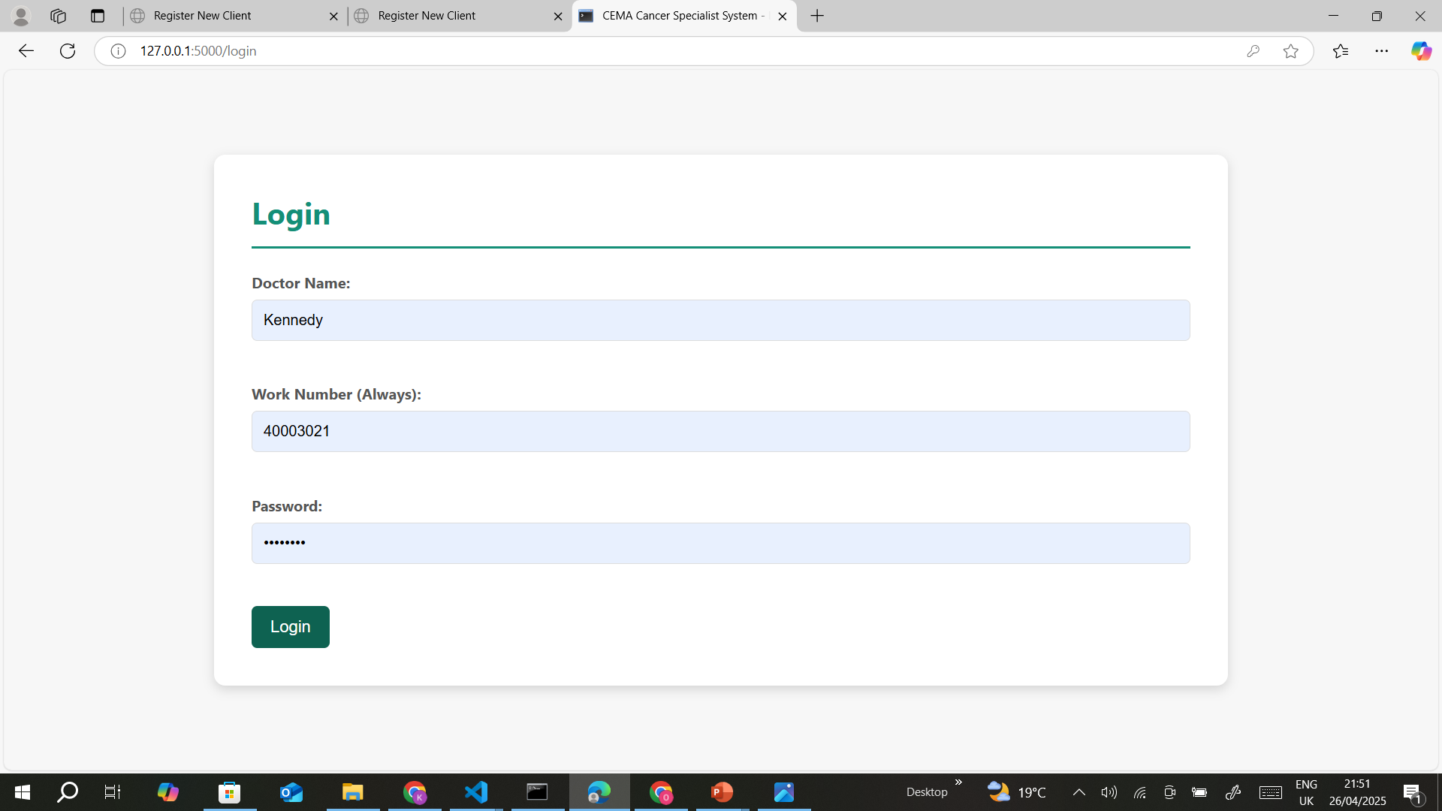

Slide 13
PROtotype design

Slide 14
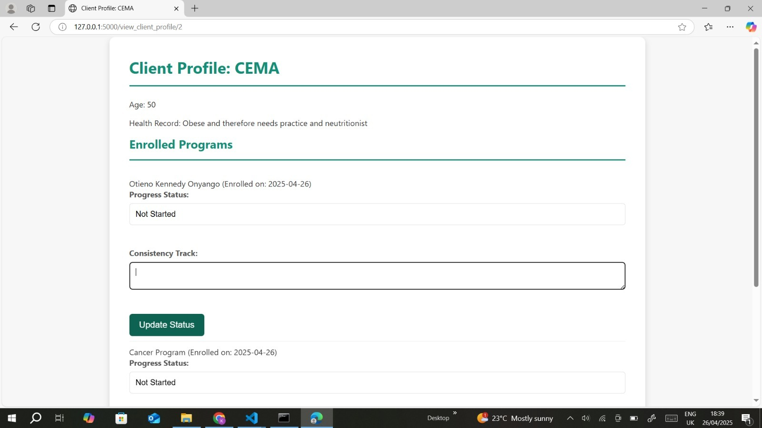
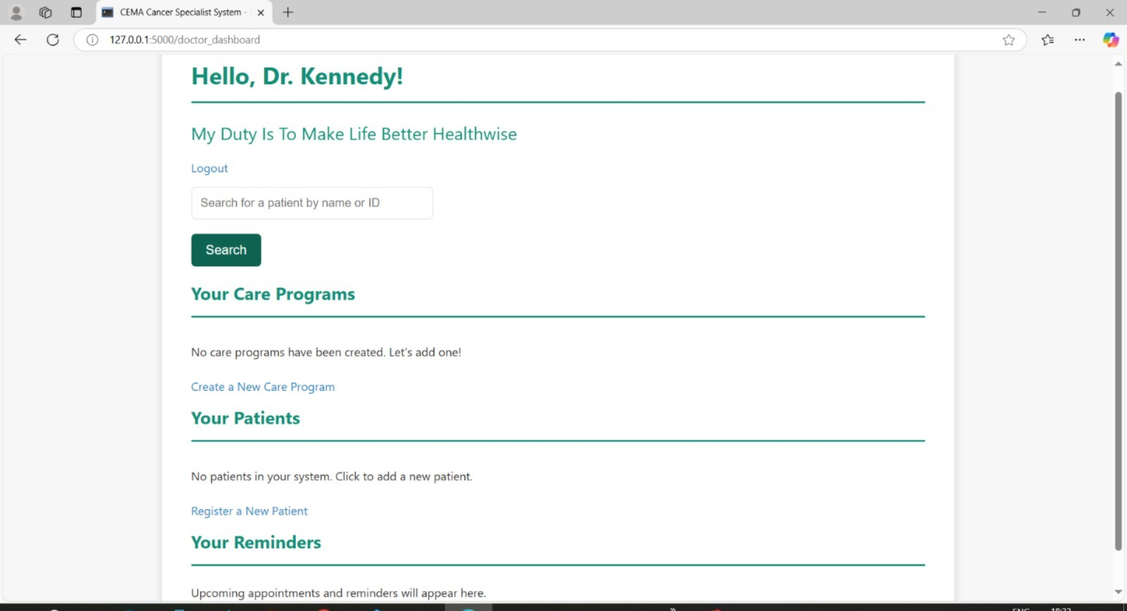

Slide 15
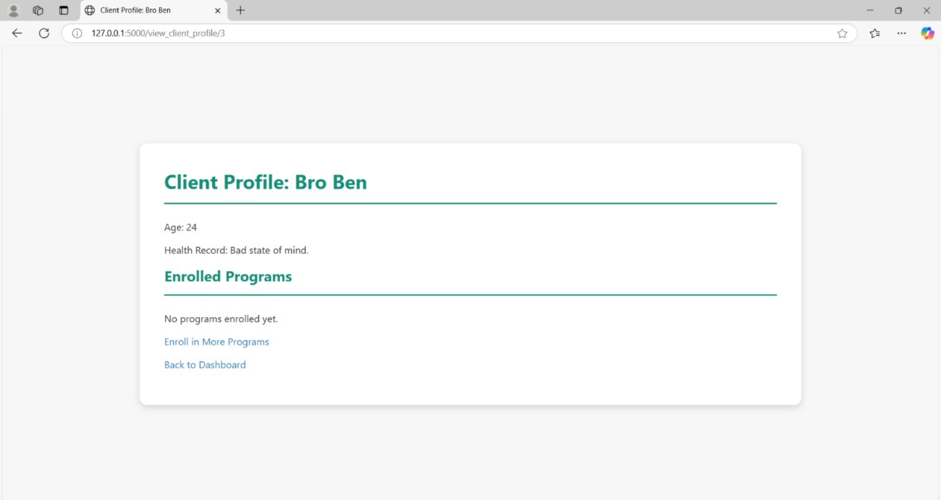
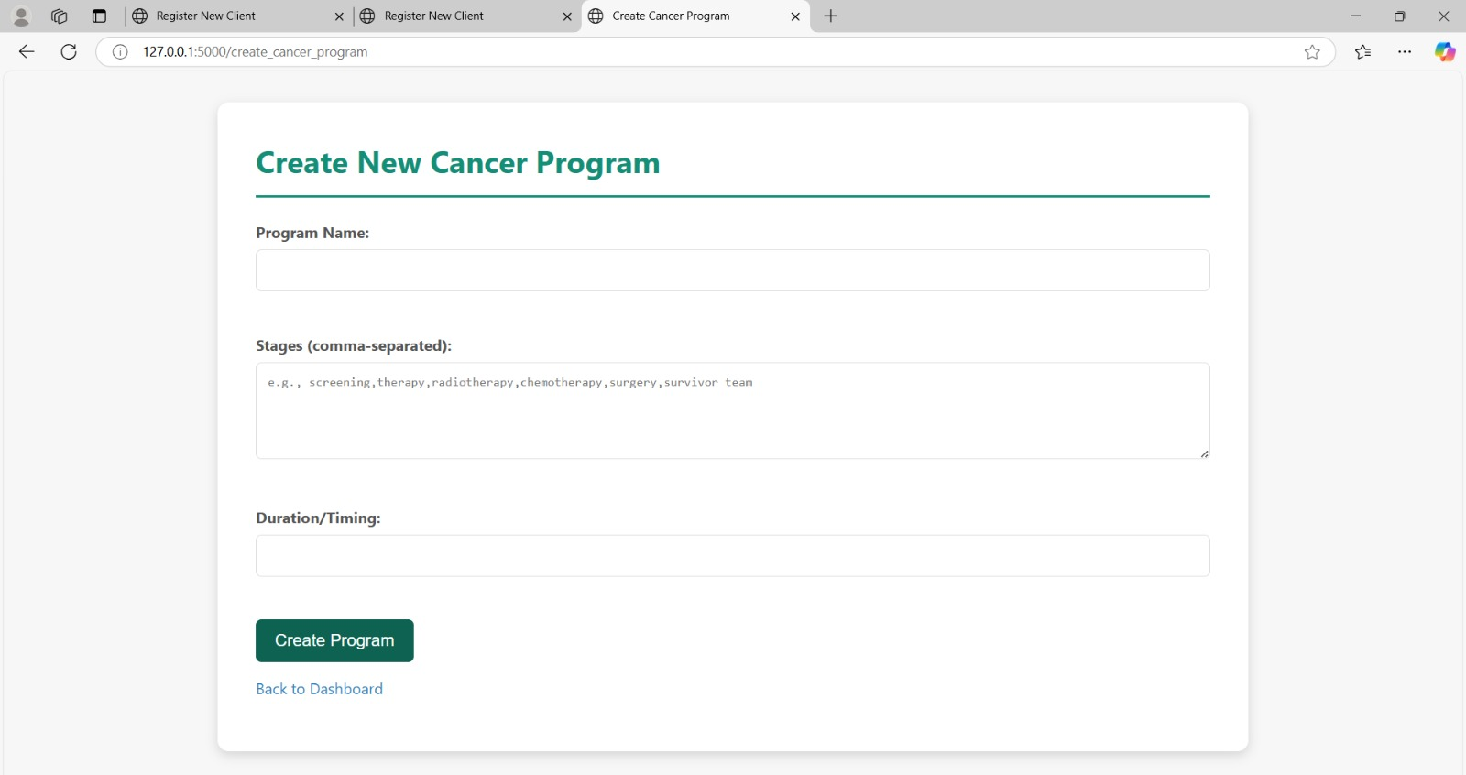

Slide 16
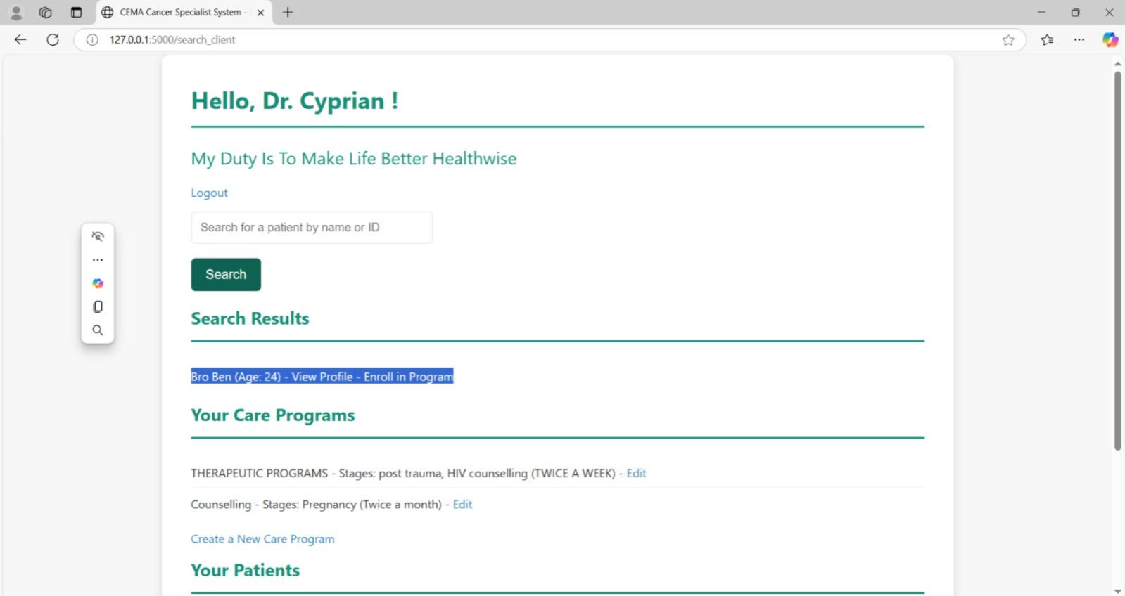

Slide 19
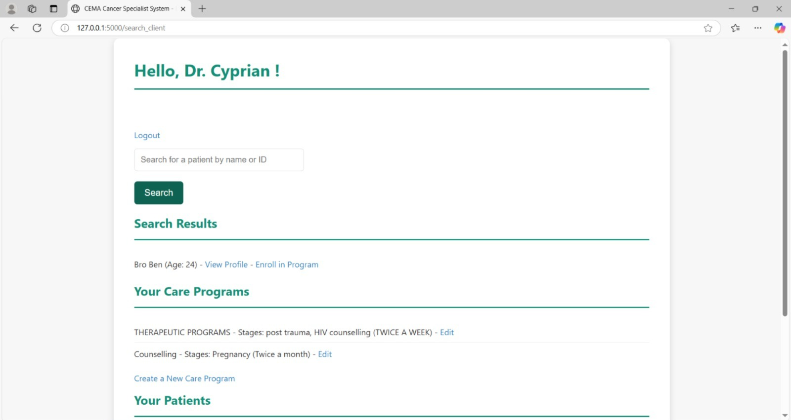
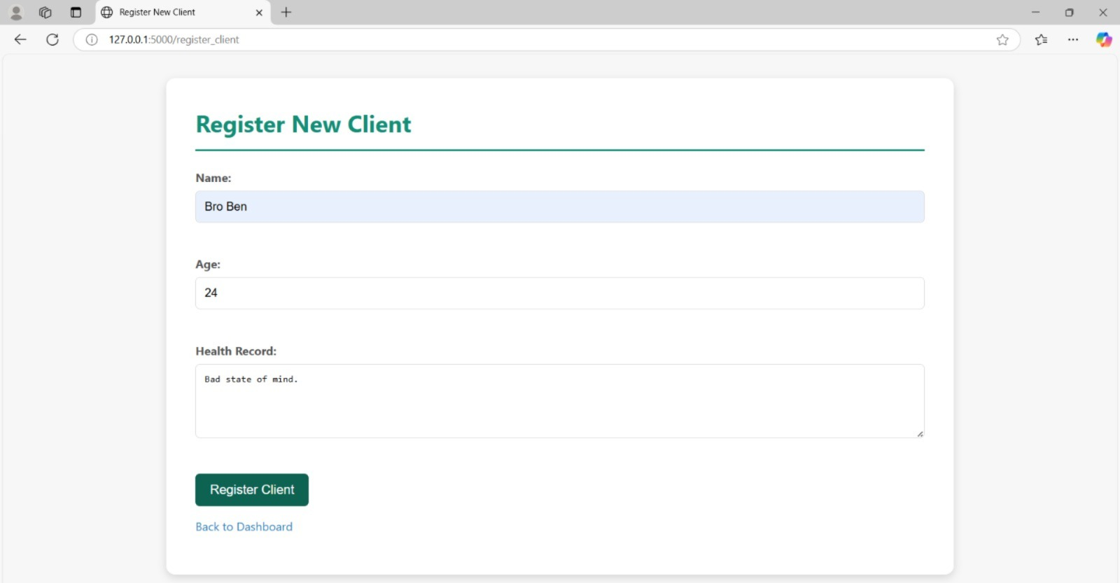

Slide 20
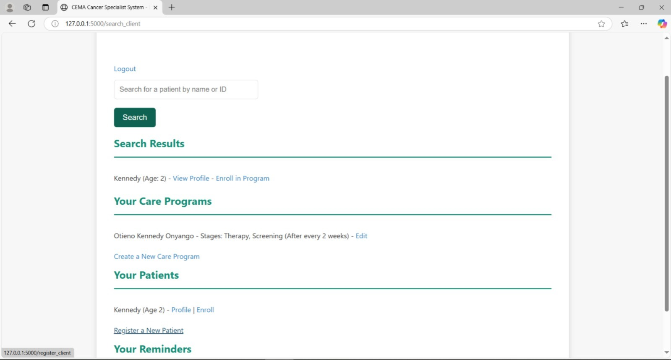

Slide 21
